Slide 1

Building real-time messaging app with Angular and Firebase
Bünyamin Coşkuner

Slide 2
Agenda
Angular
Firebase
Functional Requirements
Architecture
Demo

Slide 3
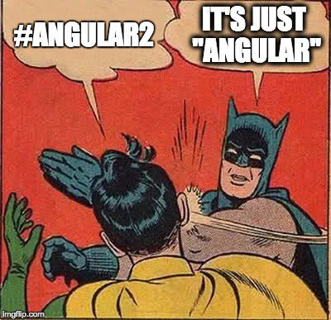
Angular
MVC framework, SPA apps
Started as a side project in 2009
Version 1.0 in May 2011
AngularJs -> v1.x
angularjs.org
Angular -> v2+
angular.io

Slide 4
Angular
TypeScript
https://www.typescriptlang.org/play/index.html
RxJS
https://rxjs.dev/

Slide 5

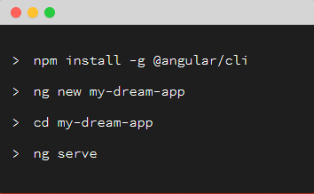

Angular
CLI
https://cli.angular.io/
Material
https://material.angular.io/

Slide 6
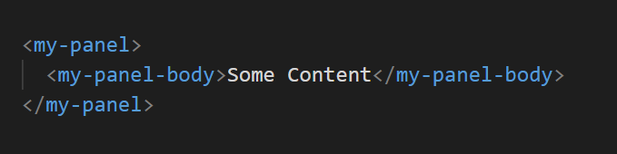
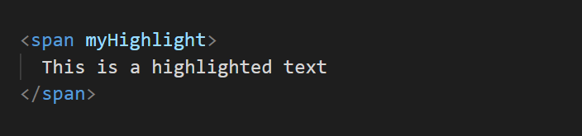
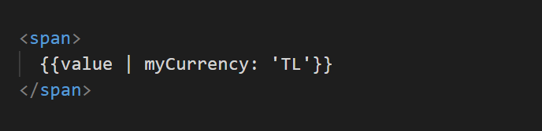
Angular
@NgModule({
imports: [NgModule],
declarations: [
@Component,
@Directive,
@Pipe
],
providers: [@Injectable],
exports: [NgModule, …declarations]
})
export class AppModule {}

Slide 7
Firebase
Firebase Real-time Database
Firebase hosting

Slide 8
Functional Requirements
Users should be able to choose a name
Users should be able to see online users
Users should be able to see the count of online users
Users should be able to see the count of registered users
Users should be able to send and receive messages

Slide 9
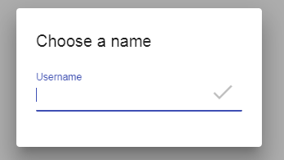
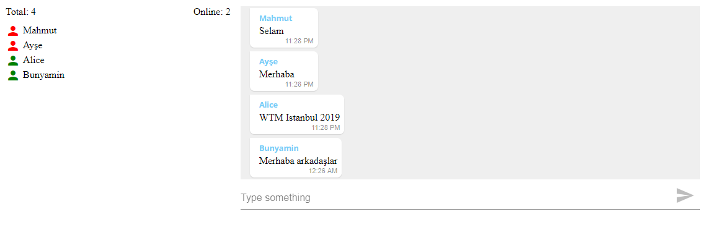

Slide 10
Architecture
App
Core
Message-Panel
Users-Panel
Shared
Login
UsernameDialog
FirebaseService
UserService
MessageService
MessagePanel
Message
MessageInput
UsersPanel
UserInfo
UserCountPipe
Input

Slide 11


Slide 12
Thank you

